Slide 1
INT253 WEB DEVELOPMENT IN PYTHON USING DJANGO
Lecture #0

Slide 2




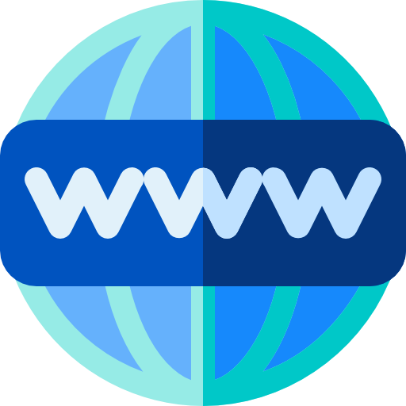


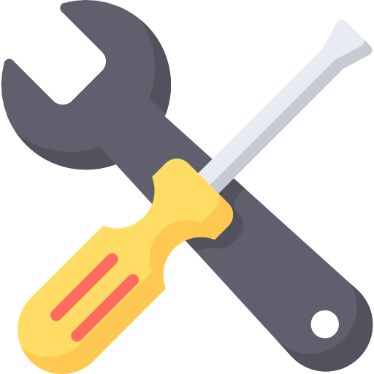


A web framework provides tools to create a website easily
What is a Web Framework?
Web
Frame
Work

Slide 3
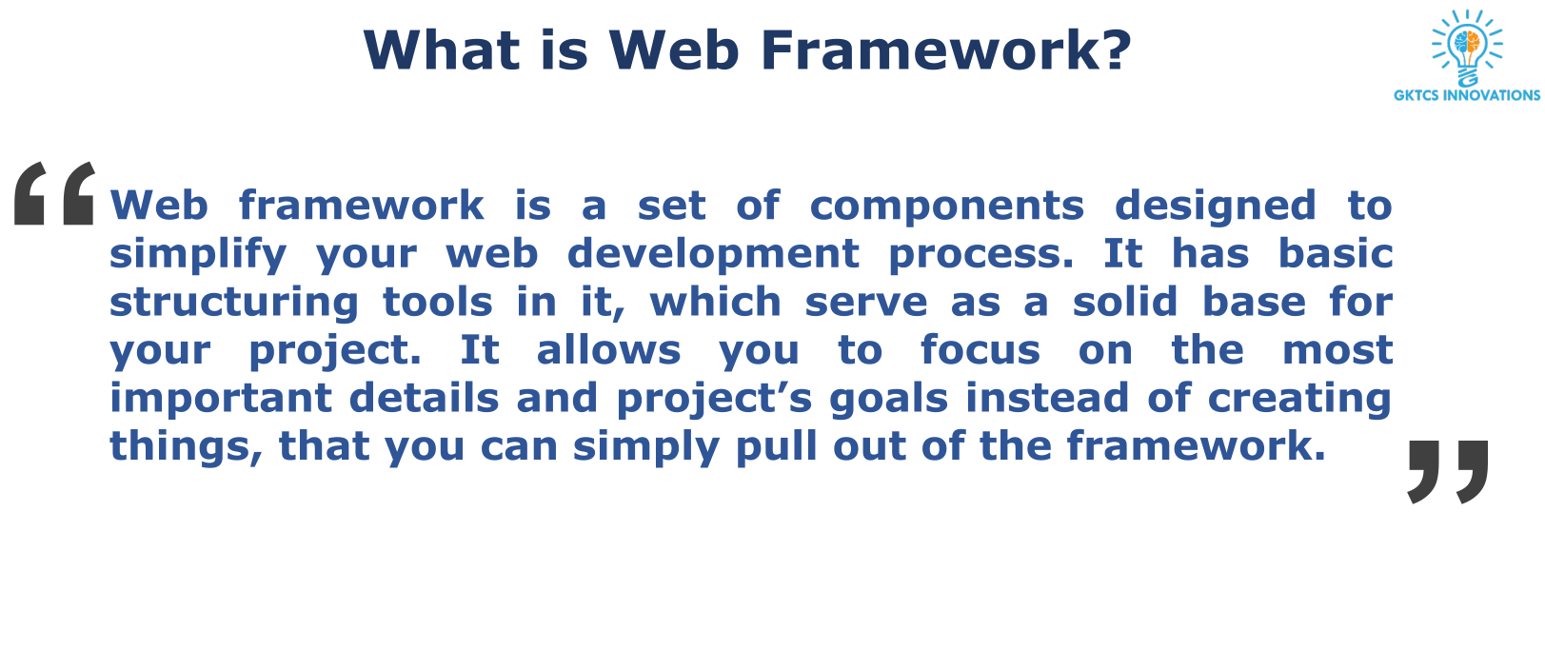

Slide 4
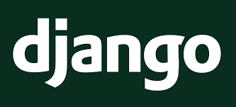
What is Django ?

Slide 5
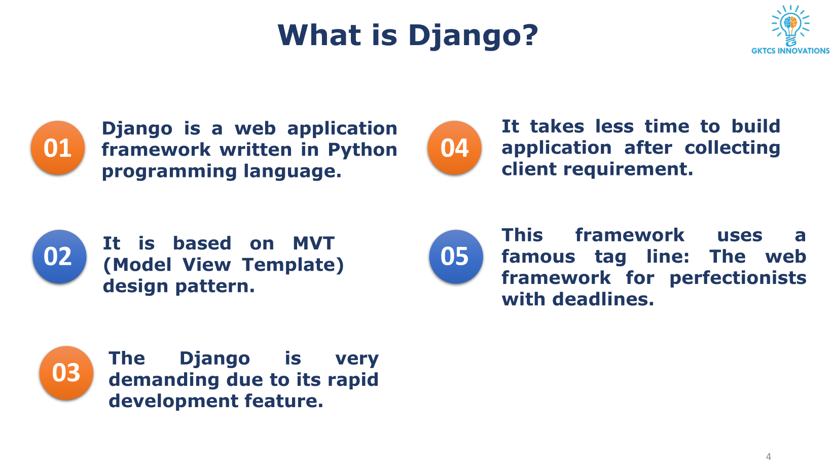

Slide 6
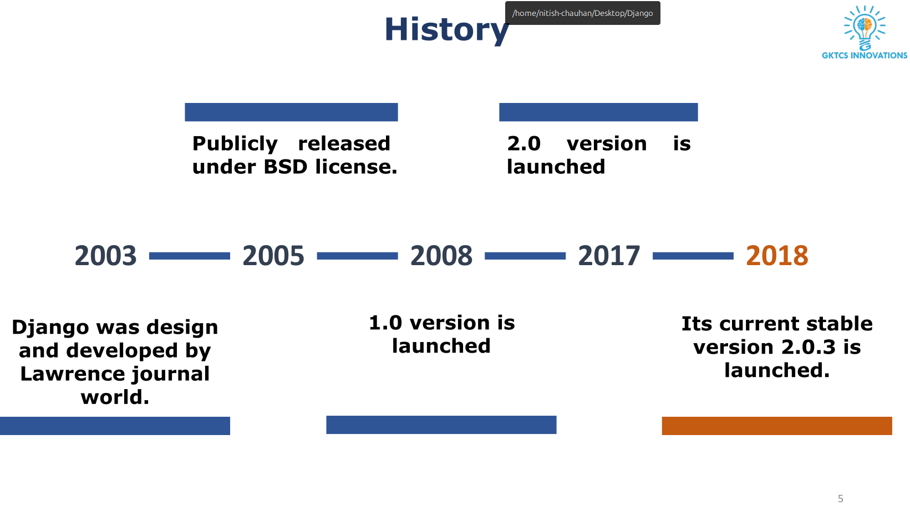

Slide 7
History of django
Inception (2003):
Django was developed by Adrian Holovaty and Simon Willison.
Started as an internal project at the Lawrence Journal-World newspaper in Kansas, USA.
Open Source Release (2005):
Released as an open-source web framework in July 2005.
Aimed at easing the development of complex, data-driven websites.
Django Software Foundation (2008):
Django gained community support and formed the Django Software Foundation (DSF) in 2008.
DSF oversees Django's development and promotes its use.
Version 1.0 (2008):
Django 1.0 was released in September 2008, marking stability and maturity.
Widely adopted in the web development community.
Introduction of Django REST Framework (2011):
Django REST Framework was introduced to simplify building Web APIs.
Enabled the development of RESTful APIs using Django.
Migration to Python 3 (2013-2019):
Django community worked on migrating the framework to Python 3.
Django 2.0, released in 2017, officially dropped support for Python 2.
Django Channels (2016):
Introduction of Django Channels for handling WebSockets and other asynchronous protocols.
Opened the door for real-time applications and chat functionalities.

Slide 8
Why use Django?

Slide 9

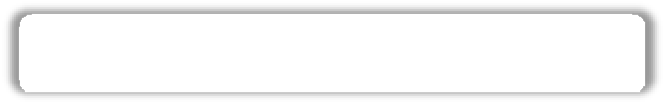

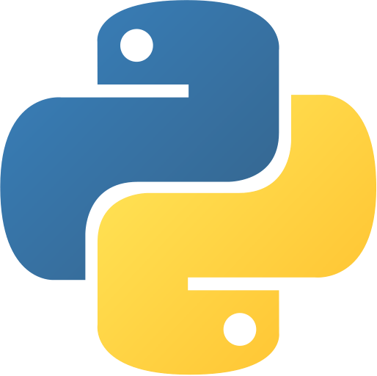
Why Django ?
1
Built on top of Python

Slide 10

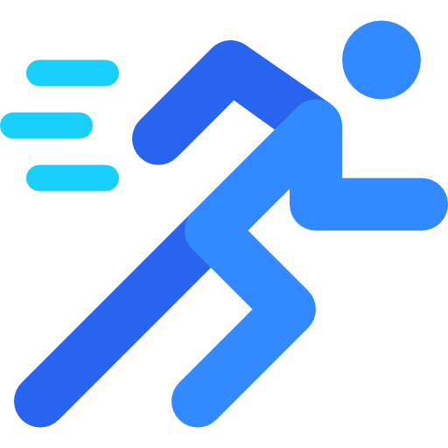
Why Django ?
2
Quick development of websites

Slide 11

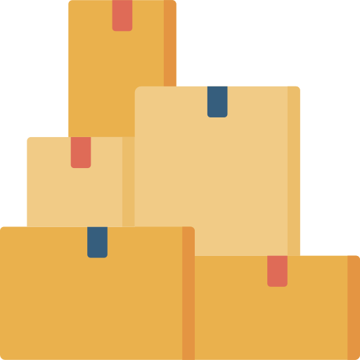
Why Django ?
3
Lots of packages

Slide 12

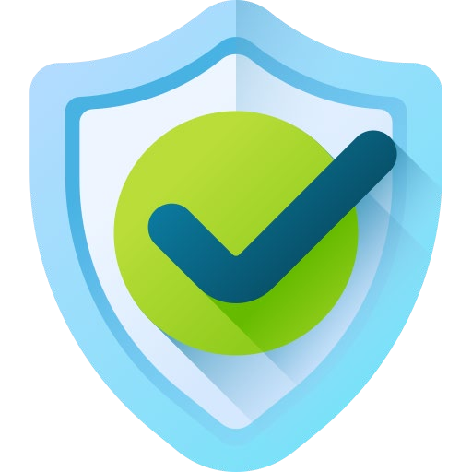
Why Django ?
4
Django provides security

Slide 13


Why Django ?
5
Django is scalable

Slide 14
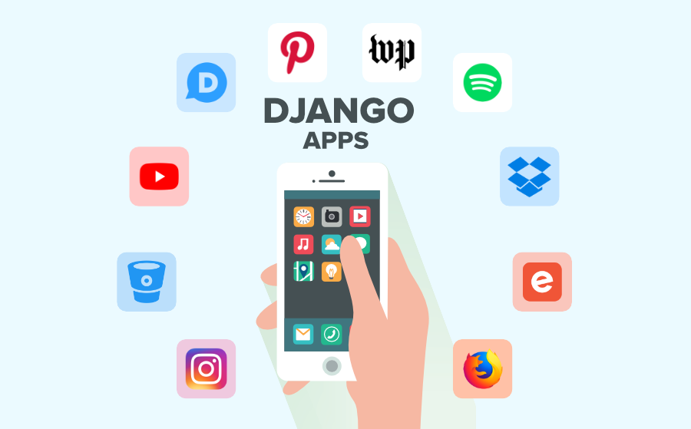
Top 10 Django Apps And Companies Are Using it

Slide 15
What is a Django Project?
A Django Project is the top-level container of a Django application. It contains the global configuration, settings, URLs, and one or more Django applications (apps) that work together to build a complete web application.

Slide 16
What is a Django App?
A Django App is a self-contained Python module that implements a specific feature or functionality of a Django project. It contains its own models, views, templates, URLs, and other components required for that feature.

Slide 17
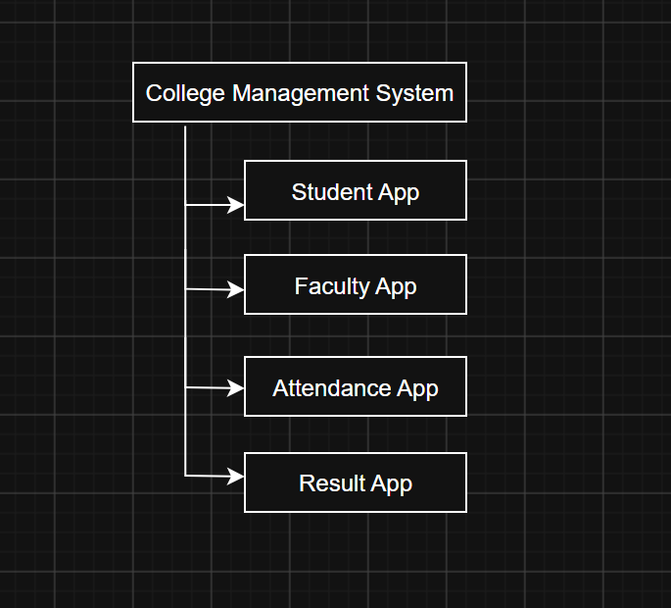
For Eg:

Slide 18
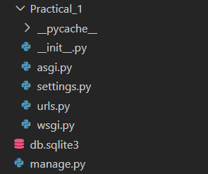
Folder structure – startproject command
manage.py - manage.py is a command-line utility that allows developers to interact with the Django project.
init.py - __init__.py tells Python that this folder should be treated as a Python package.
settings.py - Contains all project-level configurations. Everything about the project is controlled here.
urls.py - Maps URLs to Views. - /student
wsgi.py - (Web Server Gateway Interface)
asgi.py – (Asynchronous Server Gateway Interface)

Slide 19
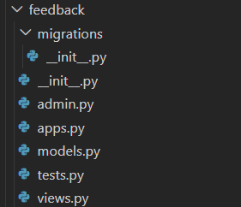
Folder structure – startapp command
init.py - This folder (feedback) is a Python package.
apps.py - It stores the configuration (basic information) of your app.
models.py - This file is used to create database tables for storing data.
views.py - This file contains the logic of your application.
admin.py - This file connects your models to Django's Admin Panel.
tests.py - This file is used to test whether your application works correctly.
migrations Folder - A migration is a file that keeps track of changes made to your models.
migrations/init.py - This file simply tells Python that the migrations folder is also a Python package.

Slide 20
django-admin and manage.py
django-admin | manage.py
Used before creating a project. | Used after creating a project.
Global Django command-line tool. | Project-specific command-line tool.
Creates new Django projects. | Manages the existing Django project.

Slide 21
Common django-admin Commands
1. Create a New Project
django-admin startproject myproject
Purpose: Creates a new Django project.
2. Check Django Version
django-admin --version
Purpose: Displays the installed Django version.
3. Display Help
django-admin help
Purpose: Shows all available Django commands.

Slide 22
Common manage.py Commands
1. Run Development Server
python manage.py runserver
Purpose: Starts the Django development server.
2. Create an App
python manage.py startapp feedback
Purpose: Creates a new Django app.
3. Create Migration Files
python manage.py makemigrations
Purpose: Detects changes in models and creates migration files.
4. Apply Migrations
python manage.py migrate
Purpose: Creates or updates database tables.

Slide 23
What is view?
View:
A View is a Python function that decides what to show to the user.
For Eg- whatever ui we are seeing
Creating View:
from django.http import HttpResponse
def home(request):
return HttpResponse("Welcome to Django")
View with Logic and Decision:
def student(request):
if request.method == "POST":
return HttpResponse("Form Submitted")
return render(request,"student.html")

Slide 24
What is url mapping?
Url mapping:
URL Mapping means connecting a URL to a View.
For Eg- /about/ → about()
/contact/ → contact()
/student/ → student()

